Slide 1
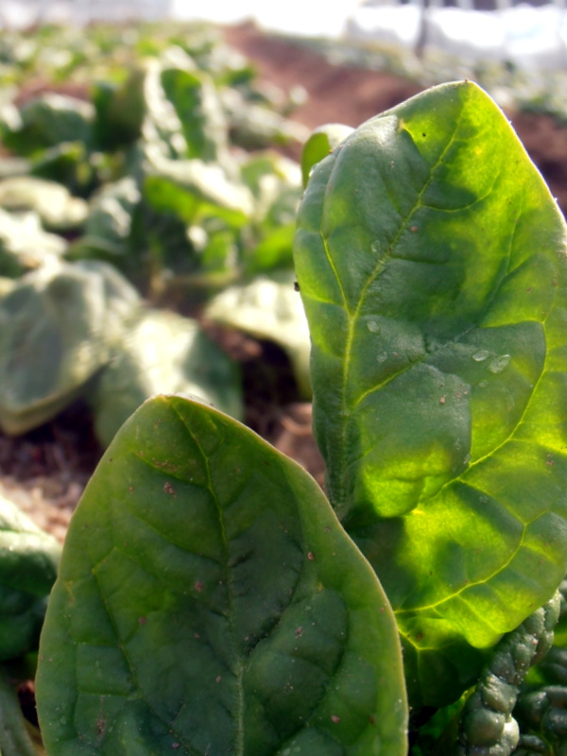
The Story of Broadfork Farm’s Winter Spinach
How was it grown?

Slide 2
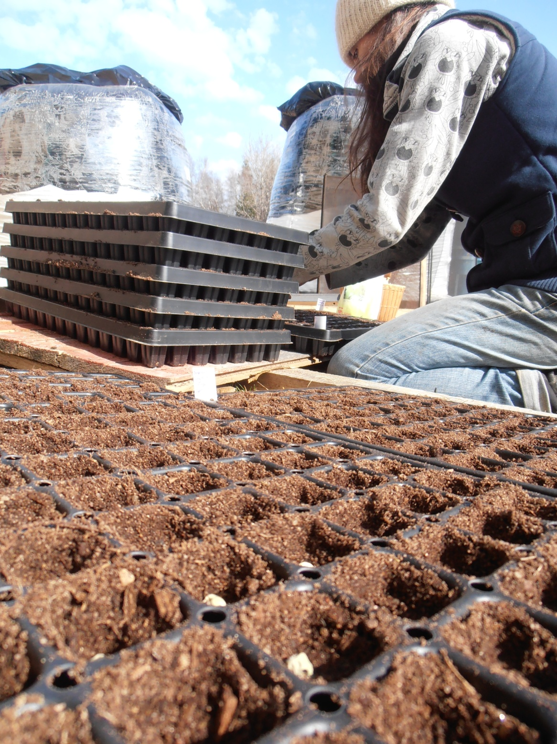
We started the seeds in trays at the end of September.

Slide 3
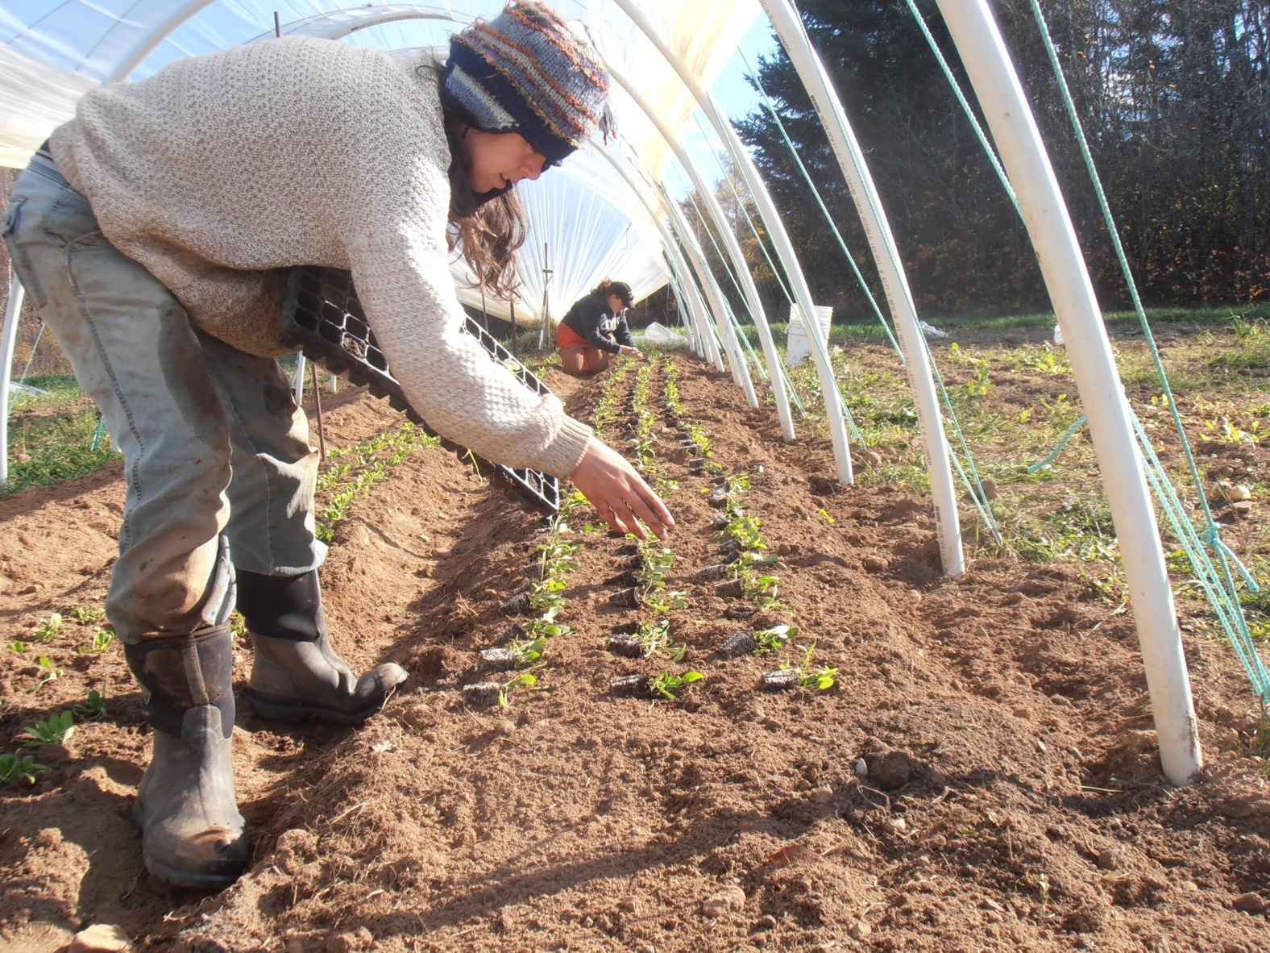
We transplanted the little spinach plants into our unheated field tunnels in the middle of October.

Slide 4
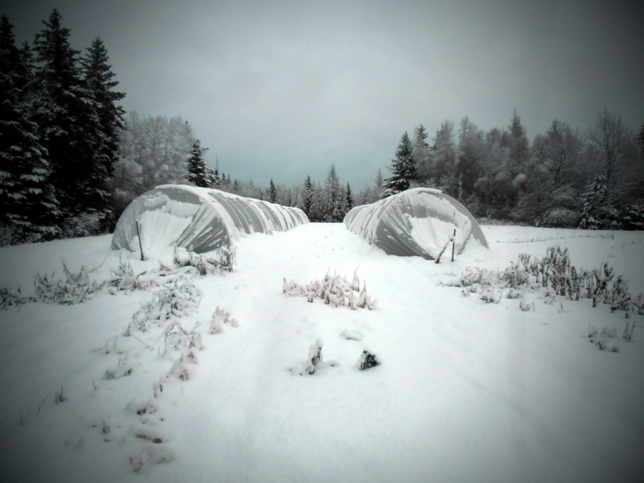
Every time it snowed, we shovelled off the tops and sides of the tunnels so they wouldn’t collapse.

Slide 5
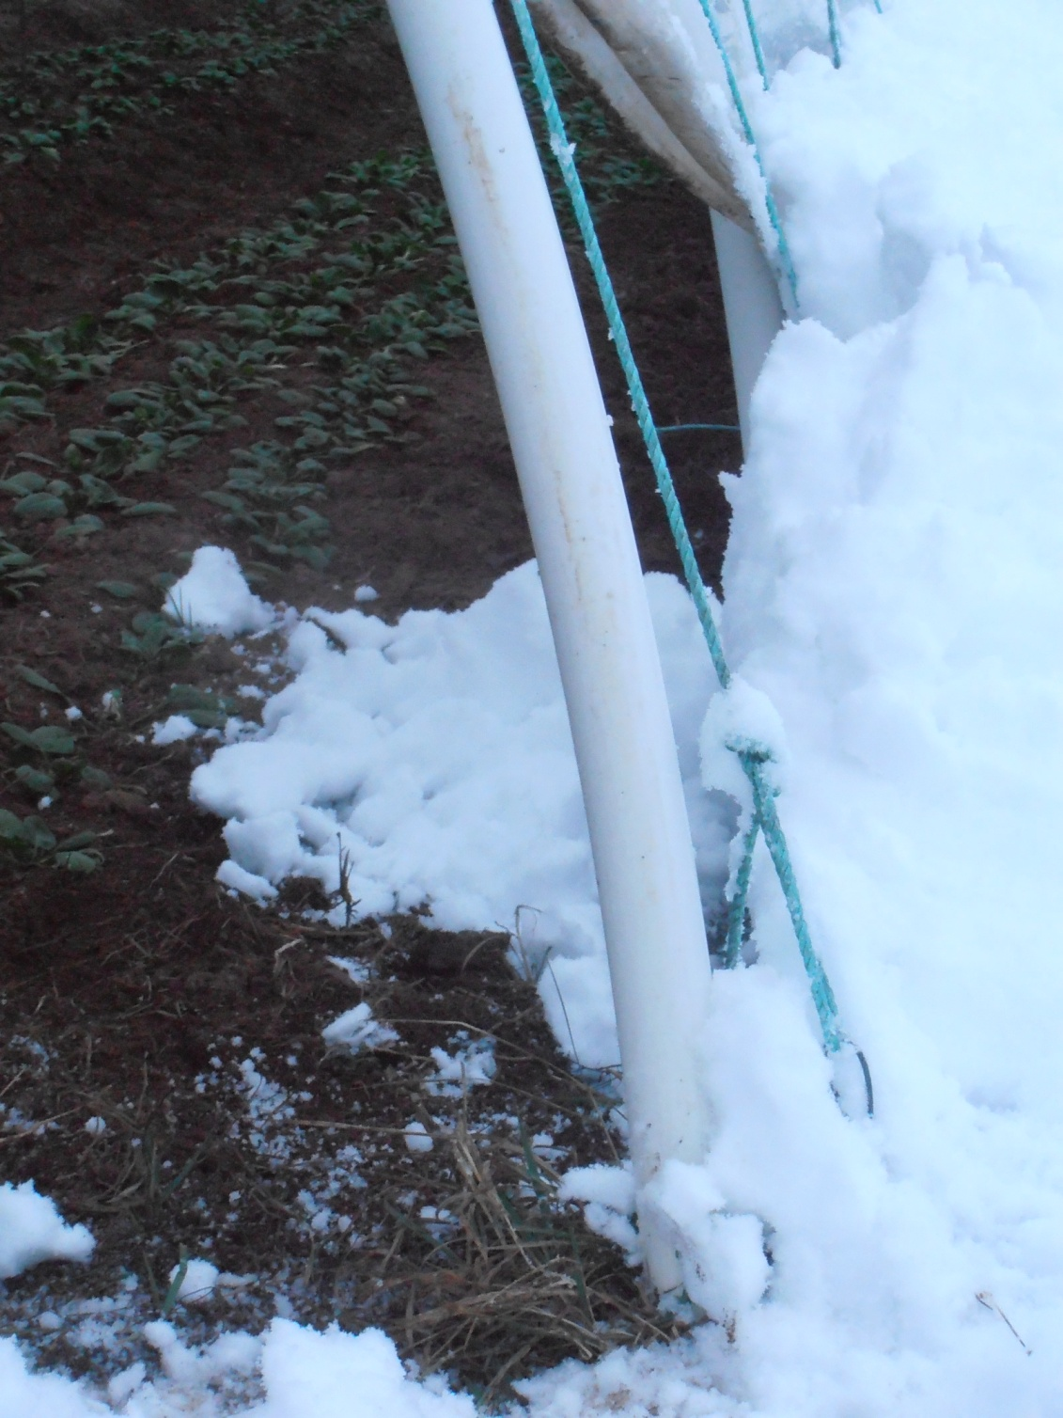
Spinach is very cold-hardy and can survive the winter if protected.
Spinach actually gets sweeter in the winter!

Slide 6
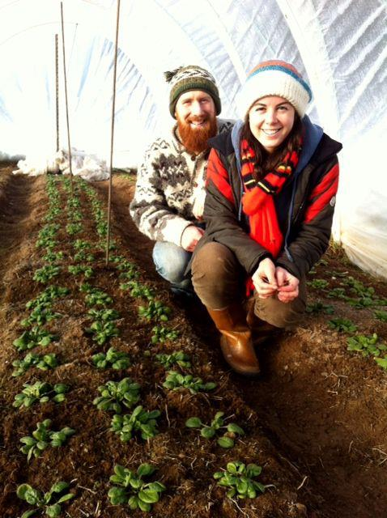
This is what the inside of the tunnel looked like in early January.

Slide 7
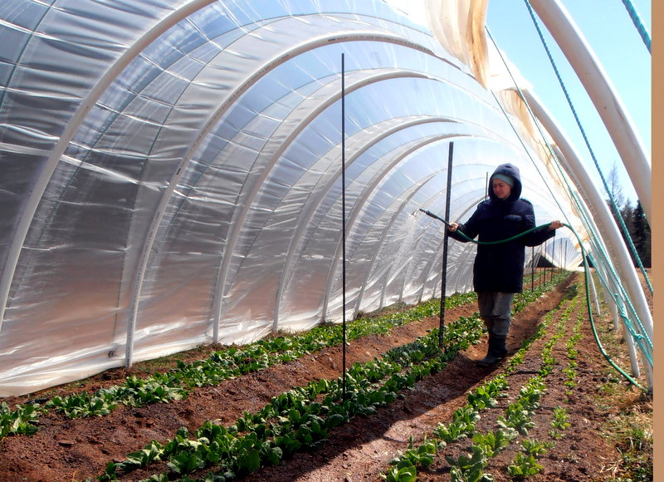
In March, we started watering the spinach every week.

Slide 8
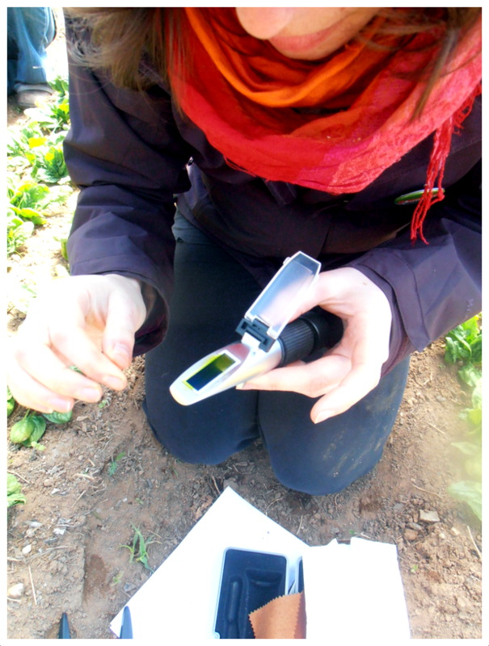
In early April, we tested the Brix levels of our spinach. It was double what we expected!

Slide 9
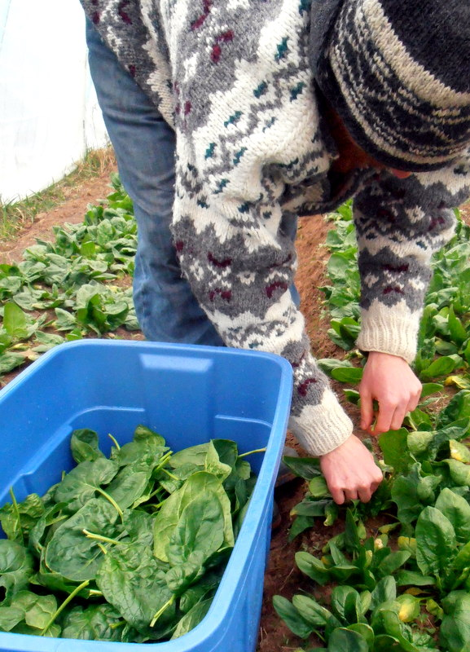
Finally, we started harvesting the spinach to bring to the Dieppe Market!

